Slide 1
A Closer Look at Methods and Classes

Slide 2
Mr. M.R. Solanki
Sr. Lecturer, Information Technology,
manish_ratilal2002@yahoo.com
SBMP

Slide 3
Learning Outcomes
Students will be able to:
Apply overloaded methods and constructors
Acquire the knowledge of call-by-value and call-by-reference concept in Java
Use static data members and member methods
Use command line arguments in a program

Slide 4
Overloaded Methods

Slide 5
Method Overloading
In Java, it is possible to define two or more methods within the same class that share the same name, as long as their parameter declarations are different
When this is the case, the methods are said to be overloaded, and the process is referred to as method overloading
Method overloading is one of the ways that Java supports polymorphism
When an overloaded method is invoked, Java uses the type and/or number of arguments as its guide to determine which version of the overloaded method to actually call
Thus, overloaded methods must differ in the type and/or number of their parameters.
While overloaded methods may have different return types, the return type alone is insufficient to distinguish two versions of a method

Slide 6
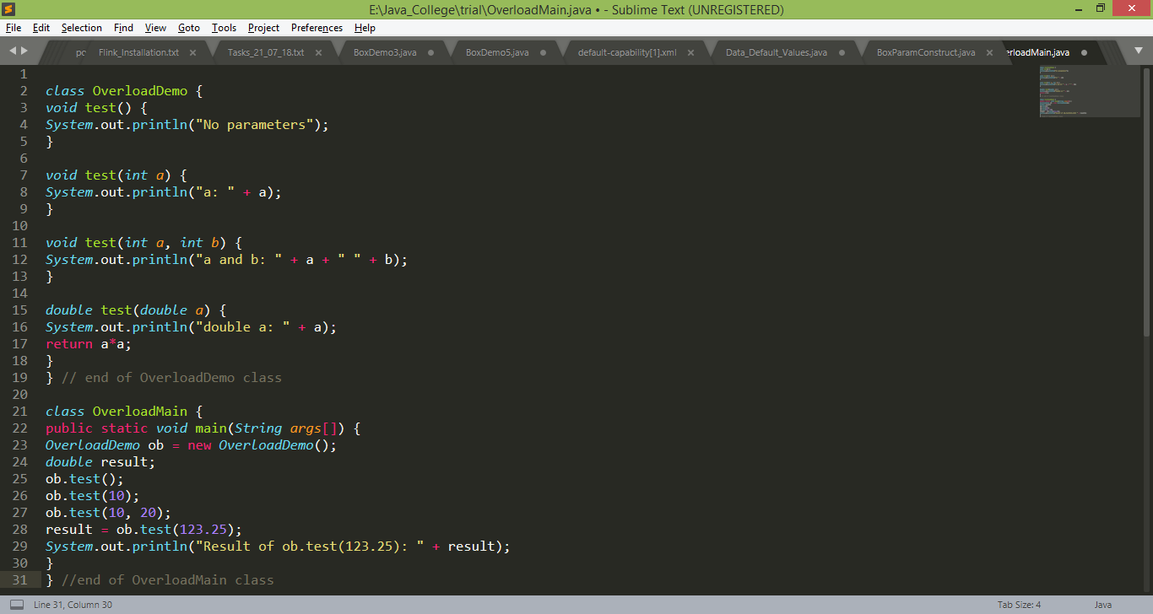
Method Overloading Program

Slide 7
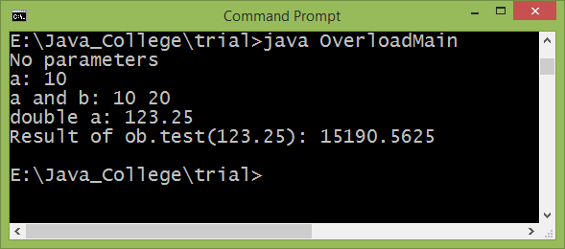
Method Overloading Program

Slide 8
When an overloaded method is called, Java looks for a match between the arguments used to call the method and the method’s parameters. However, this match need not always be exact.
In some cases, Java’s automatic type conversions can play a role in overload resolution

Slide 9
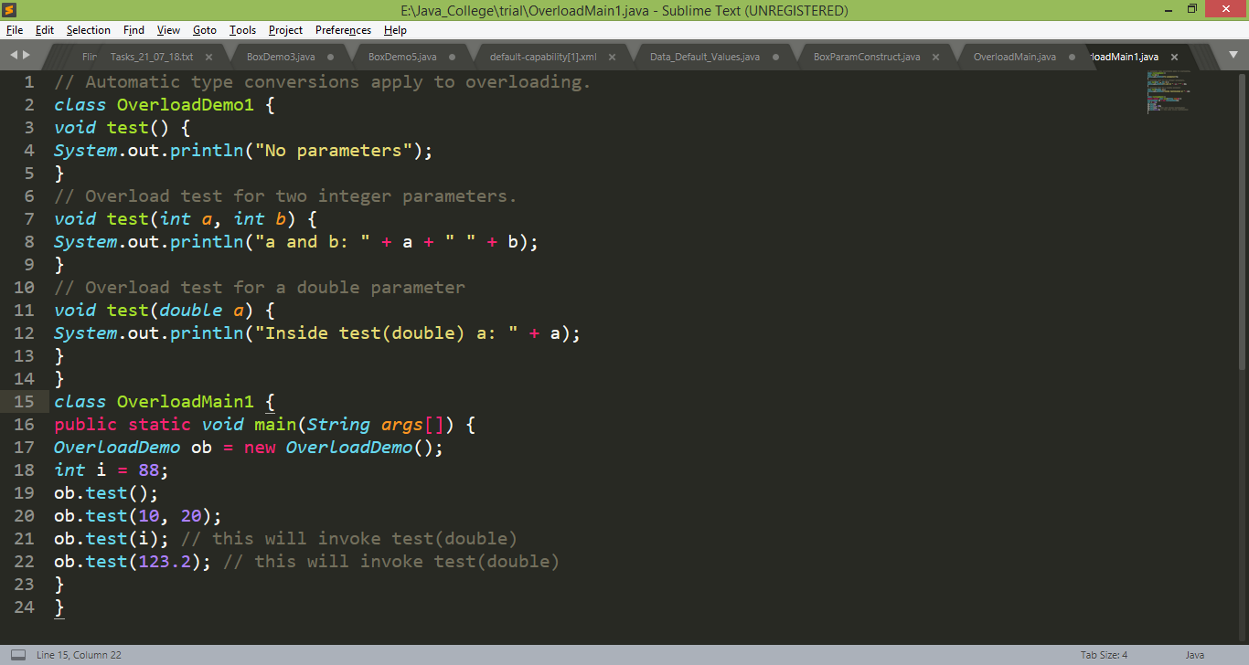
Automatic Type Promotion in Method Overloading

Slide 10
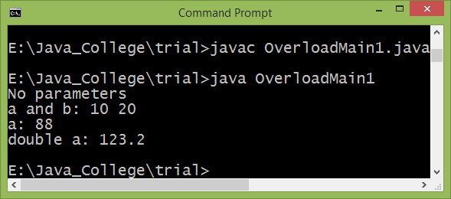
Automatic Type Promotion in Method Overloading

Slide 11
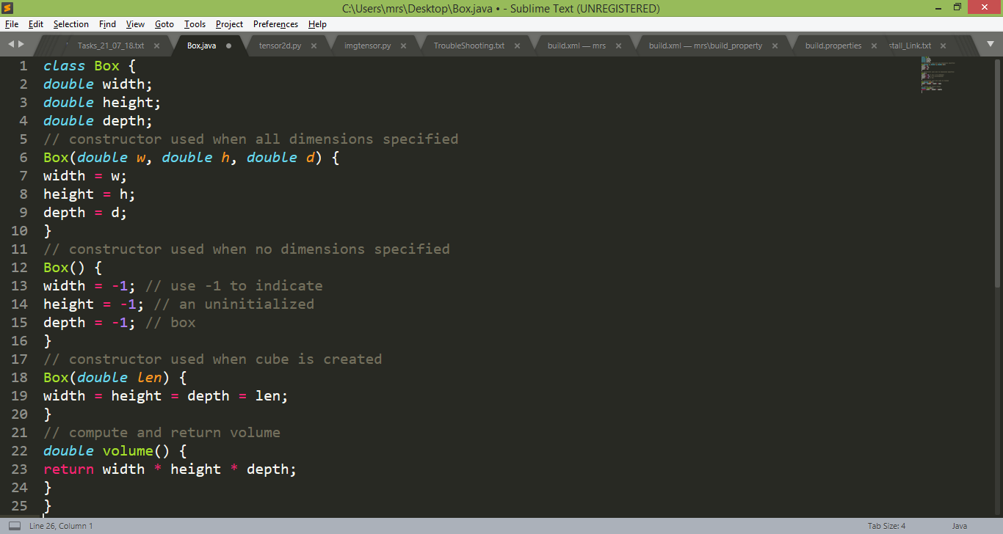
Overloading Constructors
In addition to overloading normal methods, you can also overload constructor methods.
In fact, for most real-world classes that you create, overloaded constructors will be the norm, not the exception

Slide 12
Applications of overloaded methods
In languages that do not support method overloading, each method must be given a unique name. i.e. consider the absolute value function. For instance, in C, the function abs( ) returns the absolute value of an integer, labs( ) returns the absolute value of a long integer, and fabs( ) returns the absolute value of a floating-point value
In Java, there is only one abs() method which is overloaded by Java’s Math class to handle all numeric types

Slide 13
Call-by-Value Vs Call-by-Reference

Slide 14
Call-by-value
This approach copies the value of an argument into the formal parameter of the method. Therefore, changes made to the parameter of the method have no effect on the argument
Example:
class Test {
void meth(int i, int j) {
i *= 2;
j /= 2;
} }
class CallByValue {
public static void main(String args[]) {
Test ob = new Test();
int a = 15, b = 20;
System.out.println("a and b before call: " +
a + " " + b);
ob.meth(a, b);
System.out.println("a and b after call: " +
a + " " + b);
} }

Slide 15
Java uses call-by-value to pass all arguments, the precise effect differs between whether a primitive type or a reference type is passed
When primitive types are passed to the method, they are passed by value

Slide 16
Call-by-reference
In this approach, a reference to an argument (not the value of the argument) is passed to the parameter. Inside the method, this reference is used to access the actual argument specified in the call.
This means that changes made to the parameter will affect the argument used to call the method
Example:
class Test {
int a, b;
Test(int i, int j) {
a = i;
b = j;
}
// pass an object
void meth(Test o) {
o.a *= 2;
o.b /= 2;
}
}

Slide 17
Call-by-reference
Example: class PassObjRef {
public static void main(String args[]) {
Test ob = new Test(15, 20);
System.out.println("ob.a and ob.b before call: " +
ob.a + " " + ob.b);
ob.meth(ob);
System.out.println("ob.a and ob.b after call: " +
ob.a + " " + ob.b);
}
}
Note: When you pass reference to a method, the parameter that receives it will refer to the same object as that referred to by the argument. This effectively means that objects act as if they are passed to methods by use of call-by-reference

Slide 18
When an object reference is passed to a method, the reference itself is passed by use of call-by-value. However, since the value being passed refers to an object, the copy of that value will still refer to the same object that its corresponding argument does

Slide 19
Passing and returning objects to and from the method
While passing object(reference) as a parameter, the formal argument type must be same as the class type of the actual argument
While returning object(reference) from the method, the return type of the method must be same as the type of object being returned. The same rule is applied to the recipient reference (inside the caller)
Example: Addition of 2 Complex numbers program

Slide 20
Static data members and methods

Slide 21
static members
Normally, a class member must be accessed only in conjunction with an object of its class. However, it is possible to create a member that can be used by itself, without reference to a specific instance.
To create such a member, precede its declaration with the keyword static
When a member is declared static, it can be accessed before any objects of its class are created, and without reference to any object
We can declare both methods and variables to be static
The most common example of a static member is main( ) main( ) is declared as static because it must be called before any objects exist

Slide 22
static members
Instance variables declared as static are, essentially, global variables
When objects of its class are declared, no copy of a static variable is made. Instead, all instances of the class share the same static variable
Methods declared as static have several restrictions:
They can only directly call other static methods
They can only directly access static data
They cannot refer (access) to this or super in any way
Note: if you wish to call a static method from outside its class, you can do so using the following general form:
classname.method( )
Here, classname is the name of the class in which the static method is declared

Slide 23
static data and method example
class StaticDemo {
static int a = 42;
static int b = 99;
static void callme() {
System.out.println("a = " + a);
}
}
class StaticMain {
public static void main(String args[]) {
StaticDemo.callme();
System.out.println("b = " + StaticDemo.b);
}
}

Slide 24
class Employee
{
int code,basic;
float gross;
static Scanner sc=new Scanner(System.in);
void setEmp()
{
code=sc.nextInt();
// other variable input
}
}

Slide 25
class EmployeeTest
{
public static void main(String args[])
{
int i,n;
System.out.println("How many employees you want to add?");
n=Employee.sc.nextInt();
// Remaining Code
}
}

Slide 26
Applications of static data members
All mathematical methods defined by Math class are static
We can keep track of number of objects created in the code
We can keep one Scanner reference in a class which can be used throughout the code
We can keep reference of an array of objects and can be used throughout the code

Slide 27
Command-Line Arguments
Sometimes you will want to pass information into a program when you run it
This is accomplished by passing command-line arguments to main( ).
A command-line argument is the information that directly follows the program’s name on the command line when it is
executed.
The command-line arguments inside a Java program are stored as strings in a String array passed to the args parameter of main( )
The first command-line argument is stored at args[0], the second at args[1], and so on

Slide 28
Command-Line Arguments Example
// Display all command-line arguments.
class CommandLine {
public static void main(String args[])
{
for(int i=0; i<args.length; i++)
System.out.println("args[" + i + "]: " + args[i]);
}
}
Note: length variable displays the size(length) of an array
Execution : java CommandLine this is a test 100 -1
O/P:
args[0]: this
args[1]: is
args[2]: a
args[3]: test
args[4]: 100
args[5]: -1

Slide 29
Command-Line Arguments Example
Exercise 1: Write a program to add two numbers. Read the values of input numbers through command line arguments
Exercise 2: Write a static method to find factorial of a number. Read number through command line
Hint: Use Integer.parseInt() for type casting from String to integer. Float.parseFloat() is used for flaoting point numbers

Slide 30
Thanks!
Any questions?
You can find me at:
manish_ratilal2002@yahoo.com

Slide 31
Credits
Java The Complete Reference, Ninth Edition, Herbert Schildt

